Slide 1
C-section Analysis Data Processing Workflow
How ARCH and MARCH birth certificate, urban/rural, gestational age, and pregnancy weight change data were prepared for analysis
Data processing only · No model results
Prepared for internal research workflow documentation

Slide 2
Processing objective
Create clean, analysis-ready ARCH and MARCH datasets while preserving raw data.
Primary outcome
Key predictors prepared
Design principle
Delivery mode was recoded from birth certificate delivery route into a binary outcome: C-section vs. vaginal delivery.
Urban/rural classification, maternal age, singleton status, prior birth/birth order, pregnancy weight change, gestational age, BMI.
Raw birth certificate files are kept unchanged. All recoding and merging are done on selected working datasets.
High-level workflow
Raw data import
Variable selection
Cleaning & recoding
External merges
Processed outputs

Slide 3
Data sources used in processing
Each source contributes a specific part of the final analytic dataset.
Source | Processing role
ARCH birth certificate | Core delivery, maternal, infant, BMI, plurality, prior birth, ARCH urban/rural fields
MARCH birth certificate | Core delivery, maternal, infant, BMI, plurality, prior birth variables
UA_MANUAL.csv | Manual ARCH UACE10 updates used to improve ARCH urban/rural classification
Urban_Rural_Info.csv | MARCH urban/rural variable UR20 linked by MARCH mother and child IDs
TPWTGSR pregnancy survey | Gestational age fallback and signed pregnancy weight change in pounds
LMP_GA_Data.csv | MARCH-only primary gestational age source using GA_Birth
Global crosswalk | Links Mom_ECHO_ID to MomID for weight-gain merge
Source
Processing role

Slide 4
Raw data are preserved; working datasets are selected early
This reduces accidental overwriting and keeps the processing pipeline auditable.
Raw objects
Working objects
Selected variable groups
arch_bc_raw
march_bc_raw
These remain unchanged after import and can be used for source-data checks.
arch_bc_work
march_bc_work
Created by selecting only variables needed for the C-section analysis workflow.
IDs · delivery route · UACE/UR · DOB variables · BMI · plurality · prior birth variables · C-section history · pregnancy risk factors · demographics
Implementation detail
The working datasets are created with select(any_of(bc_vars_keep)), so variables that exist in one cohort but not the other do not stop the pipeline.
Result: cleaner scripts, easier QC, and a clear separation between source data and processed analysis data.

Slide 5
Core birth certificate recodes
Delivery outcome and basic covariates were derived consistently for ARCH and MARCH.
Delivery route recode
Binary outcome
MD_FINAL_ROUTE values were mapped into named categories:
1 Vaginal/Spontaneous · 2 Vaginal/Forceps · 3 Vaginal/Vacuum · 4 Cesarean · 9 Unknown
delivery_binary was created as:
C-section if MD_FINAL_ROUTE = Cesarean
Vaginal if spontaneous, forceps, or vacuum
Maternal age
BMI
Singleton status
child_dob and mom_dob were created from birth date fields. Maternal age was calculated as the time interval in years. ARCH records with maternal age < 18 were excluded.
BMI = 999 was treated as missing. The cleaned BMI variable was retained as a continuous covariate.
Singleton was derived from PLURALITY:
1 = singleton birth
0 = multiple birth
Analytic data were later restricted to singleton births.

Slide 6
Urban/rural classification
ARCH and MARCH used different source variables and merge keys.
ARCH
MARCH
Birth certificate includes UACE10 and UR10, but data are child-level while arch_id is mom-level. Duplicate arch_id records were checked and deduplicated before merging manual UACE10 updates.
UR20 came from Urban_Rural_Info.csv and was linked using march_id and child_id/sampleid. This urban/rural variable was kept separate from ARCH UR10.
ARCH rule
QC emphasis
Manual UACE10 was prioritized over birth certificate UACE10. Final UR10 was set to:
R if UACE10 = R or missing
U otherwise
Duplicate ID checks were performed before merge. The logic avoids many-to-many joins and keeps one urban/rural classification per relevant mother-child record.

Slide 7
Prior birth and birth order variables
Prior birth variables were constructed from birth certificate reproductive history fields.
Input fields
Derived totals
Birth order
LASTLVBXYR
NOWLIVING · NOWDEAD · BORNDEAD
previous_children_total
had_previous_children
First birth
Second birth
Third or later birth
Live birth indicator
Any previous children
has_prior_live_birth was created using LASTLVBXYR. A year value greater than 0 indicates a previous live birth, while 0 indicates no previous live birth.
had_previous_children uses NOWLIVING + NOWDEAD + BORNDEAD. This captures previous live-born children as well as previous children born dead.
Second birth variable
The teacher’s interest in second delivery is addressed by birth_order_group and an optional is_second_birth flag based on previous_children_total = 1.

Slide 8
Pregnancy weight change and gestational age
Survey-based weight change was cleaned for both cohorts; MARCH gestational age was enhanced with LMP-derived GA.
Weight change direction
Signed weight change
Crosswalk linkage
tpwtgsr_3 indicates whether the mother had total weight gain or loss during pregnancy. Values -7 and -8 were treated as missing.
tpwtgsr_3a_lb was converted to pregnancy_weight_change_lb:
positive for gain
negative for loss
participantid was treated as mom_echo_id and joined to the global crosswalk to add MomID for cohort-specific merges.
ARCH gestational age
MARCH gestational age priority
ARCH uses gestational_age_weeks from the TPWTGSR survey source, with tpwtgsr_1 renamed during cleaning.
For MARCH, GA_Birth from LMP_GA_Data.csv was used as the primary source. If GA_Birth was missing, the TPWTGSR gestational age was used as fallback.
gestational_age_source tracks whether the final MARCH gestational age came from LMP_GA_Data or TPWTGSR.

Slide 9
Merge logic and final processed datasets
The final outputs are cohort-specific and saved as separate Excel sheets.
ARCH merge
MARCH merge
arch_bc_work was restricted to singleton births, then joined with:
• UACE-derived UR10 by arch_id
• ARCH weight gain by arch_id = MomID
march_bc_work was restricted to singleton births, then joined with:
• UR20 by march_id + child_id/sampleid
• MARCH weight gain by march_id = MomID
• GA_Birth by march_id + child_id/sampleid
Final ARCH data
Final MARCH data
arch_data includes delivery outcome, UR10, maternal age, BMI, singleton indicator, prior birth variables, birth order, gestational age, pregnancy weight change, and selected risk/demographic variables.
march_data includes parallel variables plus UR20 and gestational_age_source to document whether gestational age came from LMP_GA_Data or TPWTGSR.
Output file: c_section_processed_data.xlsx · Sheets: ARCH and MARCH

Slide 10
Quality checks built into the workflow
The cleaning script includes several checks before analysis-ready files are created.
ID type harmonization
Key IDs are converted to character before joins to avoid silent mismatches.
Duplicate checks
Repeated arch_id and UACE10 records are checked before deduplication and merge.
Missing-value handling
BMI = 999 and TPWTGSR codes -7/-8 are treated as missing.
Source prioritization
Manual UACE10 and MARCH GA_Birth are prioritized where appropriate, with fallback rules documented.
Cohort-specific structure
ARCH and MARCH are kept separate at this stage to preserve their distinct urban/rural and gestational-age sources.
Next step: run descriptive statistics and logistic models using the processed cohort-specific datasets.

Slide 11
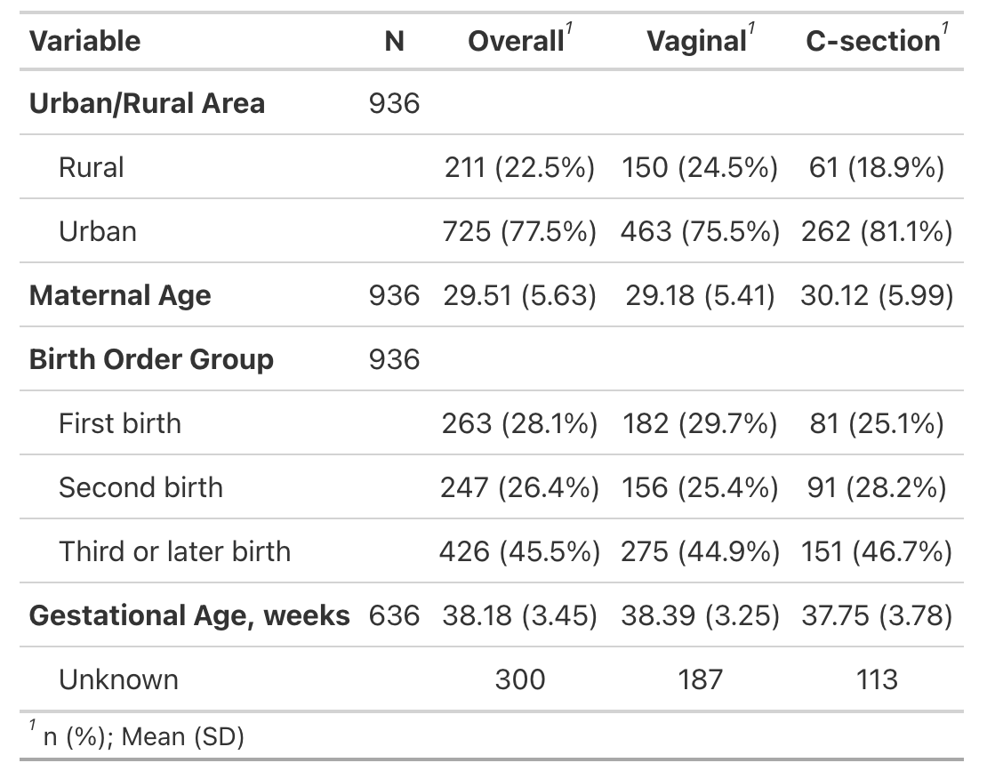
MARCH Singleton

Slide 12
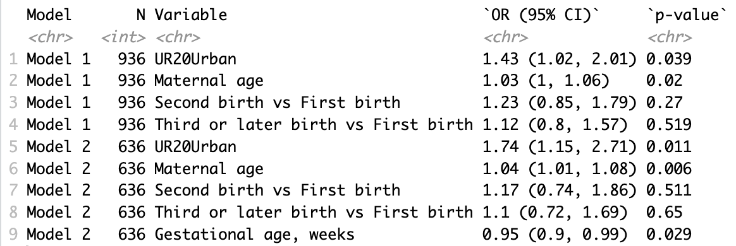
Model 1: delivery_binary ~ UR20 + maternal_age + birth_order_group Model 2: delivery_binary ~ UR20 + maternal_age + birth_order_group + gestational_age_weeks

